Slide 1
Computer Repairing and Maintain Security

Slide 2
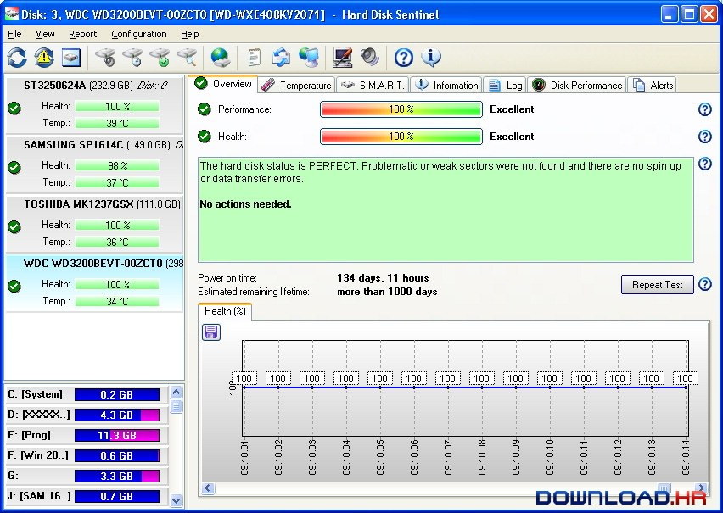
Hard disk check

Slide 3
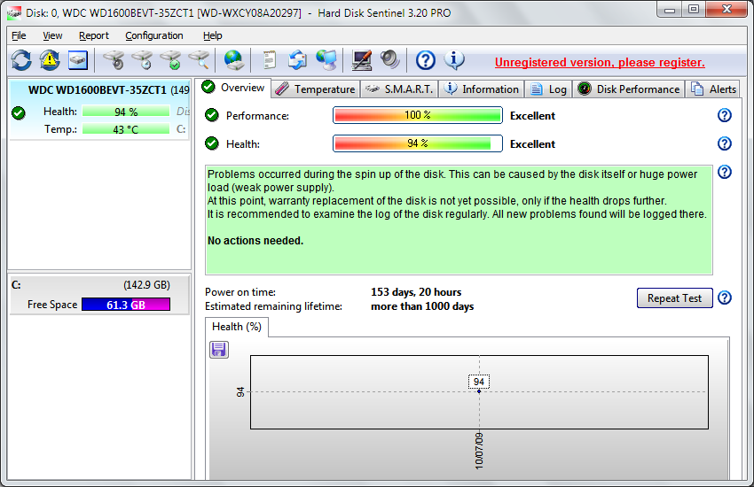
Hard disk check

Slide 4
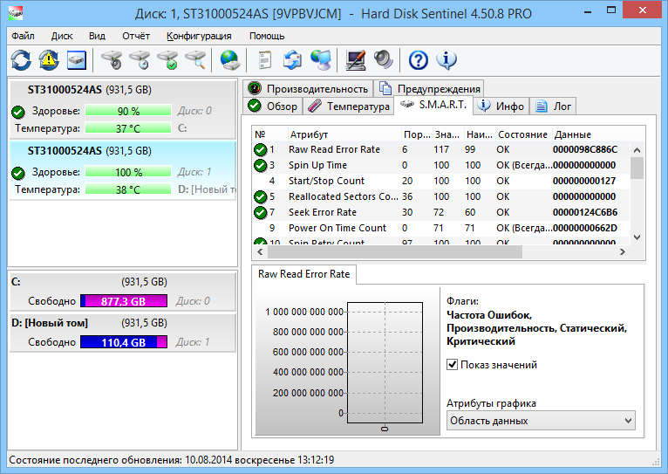
Hard disk check

Slide 5

Software
https://www.hdsentinel.com/download.php

Slide 6
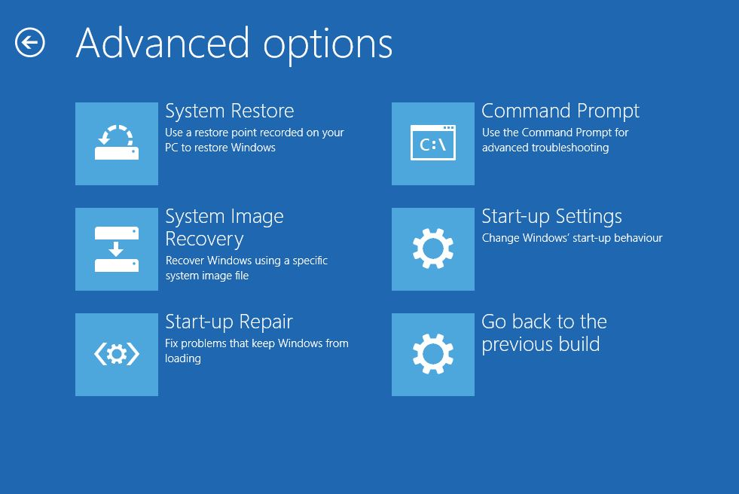
windows crash and repair
https://www.wikihow.com/Fix-a-Crashed-Computer-in-Windows#:~:text=Press%20the%20Power%20button%20to,into%20the%20Windows%20Repair%20menu.

Slide 7
Thank You!!

